Slide 1
INTRUSION DETECTION SYSTEMS USING MACHINE LEARNING
By SAJAL SAXENA

Slide 2
Host ids using adfa-ld

Slide 3
About the dataset
The Australian Defense Force Academy-Linux Dataset (ADFA-LD) consists of System Call traces which are labelled as 'Attack', ‘Training' and 'Validation’.
The system calls are obtained from Linux system.
Each trace consists of integer system calls ranging from 3 to 340.
Distribution of traces:
NORMAL TRAINING | ATTACK | NORMAL VALIDATION
833 | 746 | 4372

Slide 4
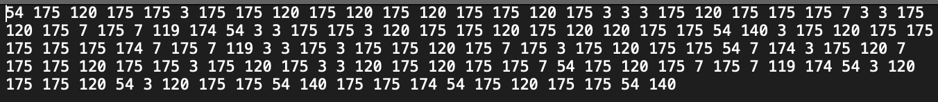
About the dataset
The attack traces consist of 6 attack classes:
Adduser
Hydra_FTP
Hydra_SSH
Java_Meterpreter
Meterpreter
Webshell
A trace from the dataset.

Slide 5
classifiers
LightGBM Classifier: Light gradient boosting machine gradient boosting framework for machine learning. It uses a leaf-wise tree growth strategy, where it grows the tree by expanding the leaf with the highest loss reduction. This can lead to faster convergence and improved performance.
XGBoost Classifier: Extreme gradient boosting is a gradient boosting algorithm and is an ensemble learning method that combines the predictions of multiple weak learners (usually decision trees) to create a strong predictive model. It is like LightGBM but differs in the way it expands the tree and how it uses histogram-based approach.
Bagging Classifier: A Bagging classifier is an ensemble meta-estimator that fits base classifiers each on random subsets of the original dataset and then aggregate their individual predictions (either by voting or by averaging) to form a final prediction. Such a meta-estimator can typically be used to reduce the variance of a black-box estimator (e.g., a decision tree), by introducing randomization into its construction procedure and then making an ensemble out of it.
Extra Trees Classifier: It implements a meta estimator that fits several randomized decision trees (a.k.a. extra-trees) on various sub-samples of the dataset and uses averaging to improve the predictive accuracy and control over-fitting.
Random Forest Classifier: It is a supervised machine learning algorithm that creates several decision trees and use voting mechanism to classify data provided to it.

Slide 6
Methodology: DS
There are three parts in an HIDS:
1.) Data Source (DS)
2.) Feature Retrieval (FR)
3.) Decision Engine (DE)
Data Source: DS for the implementation was ADFA-LD.

Slide 7
Methodology: fr
Feature Retrieval:
Extracted the Feature Vectors from the traces.
These feature vectors were aimed to summarize the trace.

Slide 8
Methodology: fr
1.) A single process P and processes P_{N}
2.) System calls S
3.) T as a trace of Nth P
4.) S_{i} =i^{th} System call in T
5.) FV¹ = min S_{i} in trace T
6.) FV² = max S_{i} in trace T
7.) FV³ = most frequent S_{i} in trace T
8.) FV⁴ = least frequent S_{i} in trace T
9.) FV⁵ = number of odd S_{i} in trace T
10.) FV⁶ = number of even S_{i} in trace T
11.) FV⁷ = average of S_{i} in trace T
12.) FV⁸ = standard deviation of S_{i} in trace T
13.) FV⁹ = number of S_{i} in trace T
14.) FV¹⁰ = unique S_{i} in trace T
11.)FM10 = FV1∩FV2∩FV3∩FV4∩FV5∩FV6∩FV7∩FV8∩FV9∩FV10

Slide 9
Methodology: DE
Decision Engine: In Decision Engine (DE), supervised learning algorithms were applied with the feature vector.
Main metrics used:
Detection Rate (DR) (Rate of detecting anomalous occurrences in the dataset)
False Alarm Rate (FAR) (Rate of falsely classifying a normal trace as anomalous)
Training was done using sklearn's train_test_split (70-30 split).
The model obtained after hyperparameter tuning was the model chosen by the DE for making predictions on the trace.

Slide 10
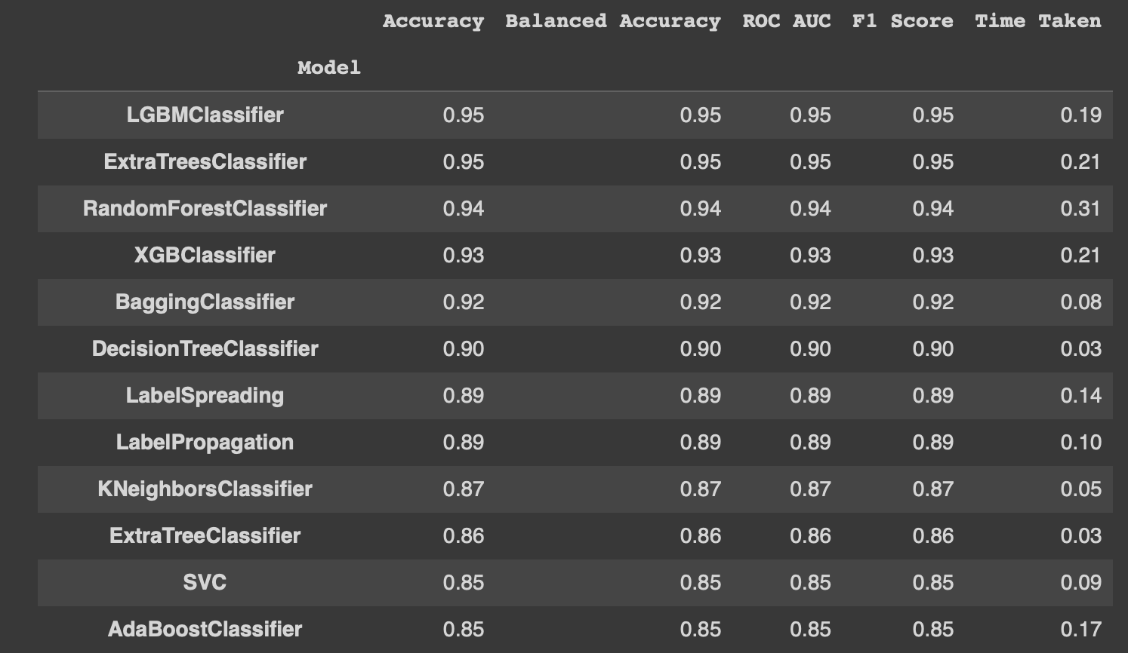
results
LazyPredict was used for evaluating model performances.
It is a python library that is used to run various machine learning models with their default parameters to provide a quick overview and evaluate the performances.
Performance of various models on FM10

Slide 11
Results
 | CLASSIFIER | DR | FAR | ACCURACY
1 | LightGBM | 96.13 | 3.79 | 96.20
2 | Extra Trees | 93.56 | 5.29 | 94.72
3 | Random Forest | 92.27 | 6.35 | 93.67
4 | XGBoost | 93.99 | 6.53 | 93.45
5 | Bagging | 90.98 | 6.99 | 93.03

Slide 12
Results
Intensive parameter tuning was performed on the most accurate classifier, LightGBM. The best results were obtained with the following parameters:
GBDT: Gradient Boosting Decision Tree is an ensemble learning machine learning algorithm that combines predictive power of decision trees with boosting algorithm.
GOSS: Gradient One Side Sampling is a data sampling strategy that prioritizes instances with high gradient magnitudes during training to improve model efficiency while maintaining predictive accuracy.
METRIC | BOOSTING TYPE | DATA SAMPLING STRATEGY | LEARNING RATE | NUMBER OF ROUNDS | ACCURACY | DR | FAR
Binary_error | Gbdt | Goss | 0.05 | 300 | 96.20 | 96.13 | 3.79

Slide 13
Network IDs using nsl-kdd

Slide 14
About the dataset
The dataset was provided by the Canadian Institute of Cybersecurity based at University of New Brunswick at Fredericton.
The NSL-KDD dataset was an improvement on the benchmark KDD'98 dataset.
It had removed redundant datapoints and duplicates from KDD'98.
The dataset has 43 features including binary labels ('Normal' and 'Anomaly').
The KDDTrain_20Percent dataset is a subset of KDDTrain+ file and has 25192 observations. This was used in the model.

Slide 15
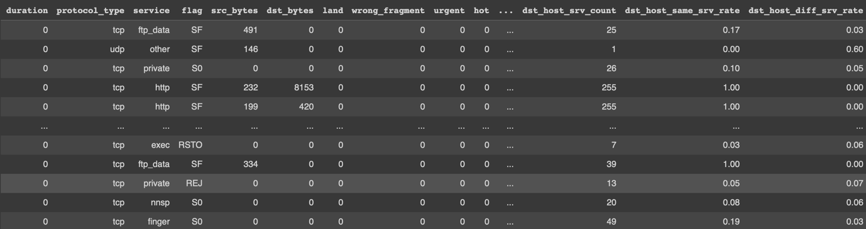
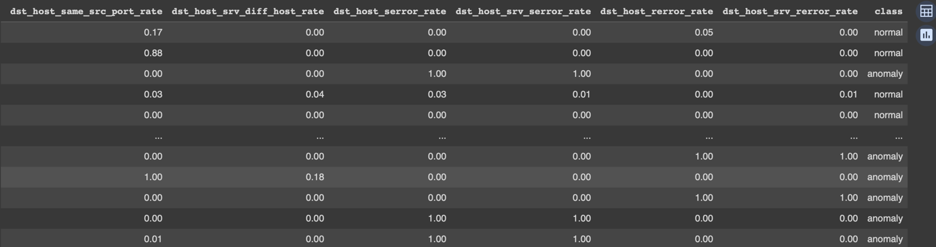
About the dataset
How the dataset looks

Slide 16
methodology
Basic data preprocessing like encoding of nominal features was performed.
Data was normalized to bring the values in the range [0,1]. This was done using 'min_max_scaler' from scikitlearn's preprocessing library.
8 features were selected: service, flag, src_bytes, dst_bytes, same_srv_rates, diff_srv_rates, dst_host_srv_count, dst_host_same_srv_rate.

Slide 17
methodology
LazyPredict classifier was run with the normalized data. The top 5 most accurate models on the list were considered for further evaluation.
The classifiers with highest accuracy were:
LightGBM Classifier
Random Forest Classifier
XGBoost Classifier
Bagging Classifier
Extra Trees Classifier:
As LightGBM was found to give results with maximum accuracy, this classifier was used for intrusion detection.

Slide 18
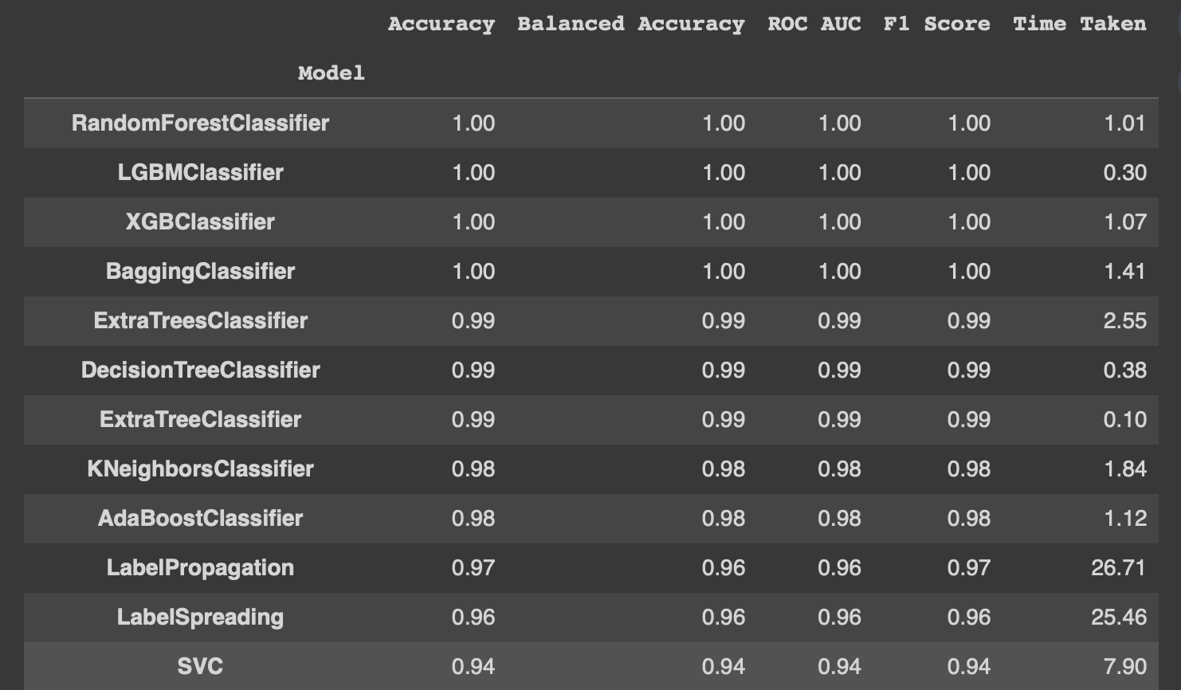
results
LazyPredict was used for evaluating model performances.
It is a python library that is used to run various machine learning models with their default parameters to provide a quick overview and evaluate the performances.
Performance of various models on NSL-KDD

Slide 19
Results
 | CLASSIFIER | DR | FAR | ACCURACY
1 | LightGBM | 99.80 | 0.18 | 99.81
2 | Random Forest | 99.77 | 0.28 | 99.70
3 | Bagging | 99.71 | 0.29 | 99.70
4 | XGBoost | 99.51 | 0.40 | 99.60
5 | Extra Trees | 99.48 | 0.51 | 99.48

Slide 20
Thank you

